Slide 1
"Predictive Analysis of Insurance Claims: Modeling the Presence of an Attorney Using Machine Learning"
K.Karunasagar

Slide 2

Business Problem
We consider 1340 bodily injury claims from a single state, USA using a 2002 survey conducted by the Insurance Research council(IRC)
The survey is conducted in order to understand the characteristics of the claimants who choose to be represented by an Attorney when settling a claim
The profit of an insurance firm is an often found to be dependent on whether the claimant appoints an Attorney or not –appointment of an attorney can often increase the amount the claimant can claim from the firm.
An insurance firm may be interested in finding the probability of a claimant appointing an Attorney
Depending on the demographic characteristics of the claimants who appoints an Attorney, the firm aims to design different policy instruments for different target groups.

Slide 3
Solution
Given a set of explanatory variables, can we predict with 100% certainty whether the claimant is represented by an attorney or not?
The response variable has only two possibilities: either the claimant is represented by an attorney or not.
It is not possible to predict with 100% certainty if a claimant is represented by an attorney based solely on explanatory variables.
The most sensible approach is to predict the probability that the claimant is represented by an attorney given a set of values for the explanatory variables.
Given a set of explanatory variables, can we predict with 100% certainty whether the claimant is represented by an attorney or not?
The response variable has only two possibilities: either the claimant is represented by an attorney or not.
It is not possible to predict with 100% certainty if a claimant is represented by an attorney based solely on explanatory variables.
The most sensible approach is to predict the probability that the claimant is represented by an attorney given a set of values for the explanatory variables.

Slide 4

Goal
The goal is to predict the probability that a claimant is represented by an attorney given a set of values for the explanatory variables, rather than trying to predict with 100% certainty whether the claimant is represented or not.

Slide 5
Benefits
Understanding the probability helps in making informed decisions regarding resource allocation, legal strategies, and case management.
Assists in strategic planning and policy formulation by providing insights into patterns and trends related to attorney representation.
Helps in the efficient allocation of resources by focusing on cases with higher probabilities of attorney representation, leading to more effective and targeted interventions.

Slide 6
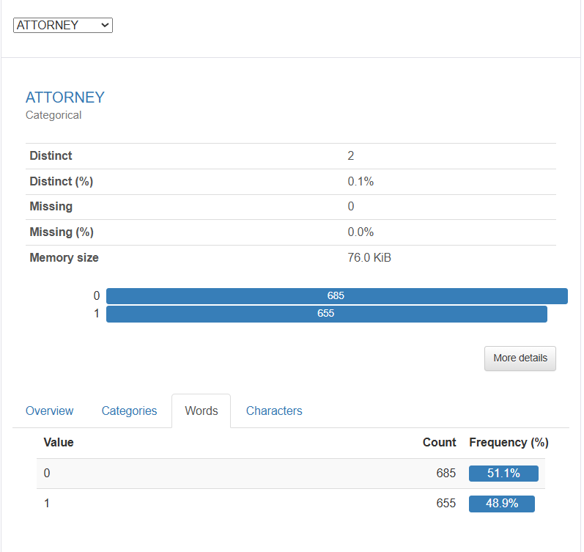
Exploratory Data Analysis (EDA)
The image shows the distribution of the "ATTORNEY" categorical variable, which indicates whether a claimant is represented by an attorney (1) or not (0). Here's a summary of the information presented:
Distinct Values: The "ATTORNEY" variable has two distinct values: 0 (not represented by an attorney) and 1 (represented by an attorney).
Distribution:
Value 0: There are 685 instances (51.1%) where the claimant is not represented by an attorney.
Value 1: There are 655 instances (48.9%) where the claimant is represented by an attorney.
Missing Data: There are no missing values for the "ATTORNEY" variable.
Memory Size: The data for this variable occupies 76.0 KiB.

Slide 7
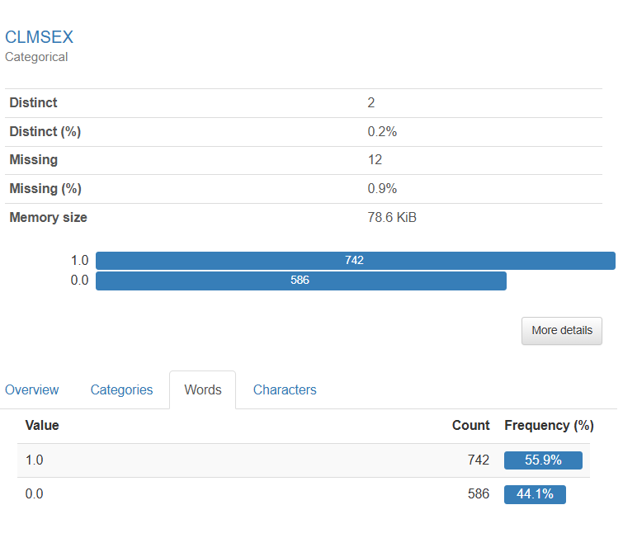
Exploratory Data Analysis (EDA)
The image shows the distribution of the "CLMSEX" categorical variable, which indicates the sex of the claimant (where 1.0 could represent one sex and 0.0 the other, such as 1.0 for female and 0.0 for male, or vice versa). Here's a summary of the information presented:
Distinct Values: The "CLMSEX" variable has two distinct values: 1.0 and 0.0.
Distribution:
Value 1.0: There are 742 instances (55.9%) of claimants with this value.
Value 0.0: There are 586 instances (44.1%) of claimants with this value.
Missing Data: There are 12 missing values for the "CLMSEX" variable, which constitutes 0.9% of the data.
Memory Size: The data for this variable occupies 78.6 KiB.

Slide 8
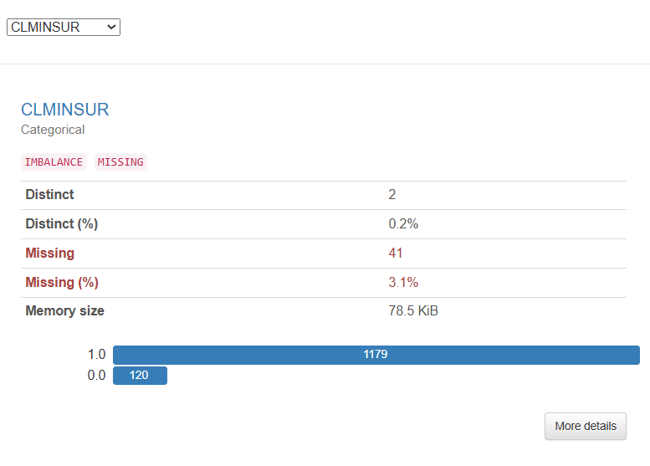
Exploratory Data Analysis(EDA)
The image shows the distribution of the "CLMINSUR" categorical variable, which indicates whether the claimant has insurance (1) or not (0). Here's a summary of the information presented:
Distinct Values: The "CLMINSUR" variable has two distinct values: 1.0 (insured) and 0.0 (not insured).
Distribution:
Value 1.0: There are 1,179 instances where the claimant is insured.
Value 0.0: There are 120 instances where the claimant is not insured.
Imbalance: The data shows a significant imbalance, with a much larger number of insured claimants compared to uninsured claimants.
Missing Data: There are 41 missing values for the "CLMINSUR" variable, which constitutes 3.1% of the data.
Memory Size: The data for this variable occupies 78.5 KiB.

Slide 9
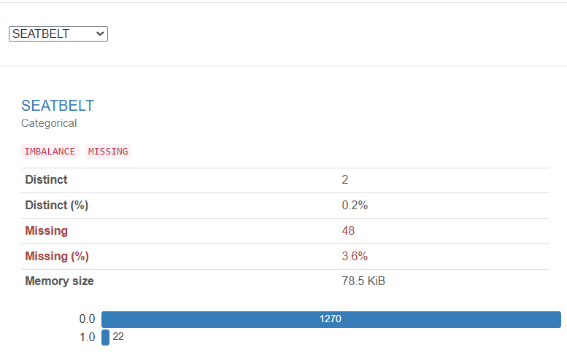
Exploratory Data Analysis(EDA)
The image shows the distribution of the "SEATBELT" categorical variable, which indicates whether a claimant was wearing a seatbelt (1) or not (0). Here's a summary of the information presented:
Distinct Values: The "SEATBELT" variable has two distinct values: 0.0 (not wearing a seatbelt) and 1.0 (wearing a seatbelt).
Distribution:
Value 0.0: There are 1,270 instances where the claimant was not wearing a seatbelt.
Value 1.0: There are 22 instances where the claimant was wearing a seatbelt.
Imbalance: The data shows a significant imbalance, with a much larger number of claimants not wearing seatbelts compared to those who were.
Missing Data: There are 48 missing values for the "SEATBELT" variable, which constitutes 3.6% of the data.
Memory Size: The data for this variable occupies 78.5 KiB.

Slide 10
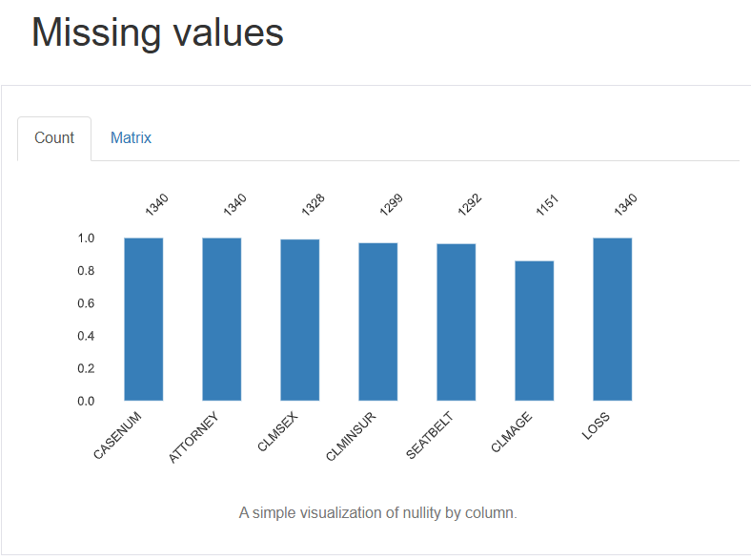
Missing Values
The image provides a bar chart visualization of missing values for different variables in a dataset. Each bar represents a variable, and the height of the bar indicates the count of non-missing values for that variable. Here is a summary:
Variables and Counts:
CASENUM: 1,340 non-missing values.
ATTORNEY: 1,340 non-missing values.
CLMSEX: 1,328 non-missing values.
CLMINSUR: 1,299 non-missing values.
SEATBELT: 1,292 non-missing values.
CLMAGE: 1,151 non-missing values.
LOSS: 1,340 non-missing values.
Missing Values:
CLMSEX: 12 missing values.
CLMINSUR: 41 missing values.
SEATBELT: 48 missing values.
CLMAGE: 189 missing values.

Slide 11

Handling Missing values and Outliers
Missing Values:
The code checks for and displays missing values.
It imputes missing values based on the type of the column (mean for numerical, mode for categorical, interpolation for datetime).
Outliers:
The code detects outliers using the IQR method.
If outliers are found, it replaces them with the median value of the column.
It provides feedback on which columns had outliers and shows the treated data if outliers were detected.
Benefits : Prepares the dataset for more accurate and reliable statistical analysis and predictive modeling.

Slide 12
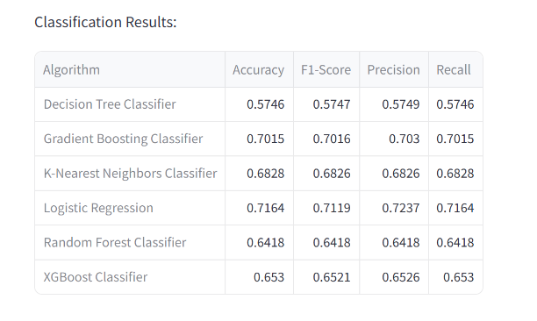
Model Comparison
The table provides performance metrics (Accuracy, F1-Score, Precision, Recall) for several classification algorithms:
Best Performing Model: Logistic Regression with the highest overall metrics.
Second Best: Gradient Boosting Classifier, showing strong and balanced performance.
Moderate Performers: KNN and Random Forest, with decent but not top-tier results.
Poor Performers: Decision Tree, which indicates underperformance possibly due to overfitting or lack of feature handling.
These results guide the selection of the most effective model for further deployment or analysis, with Logistic Regression and Gradient Boosting being the

Slide 13

Conclusions
Predictive analysis in your context involves preparing the data, selecting relevant features, training various models, and selecting the best-performing one for deployment.
Logistic Regression and Gradient Boosting showed the best results, making them good candidates for predicting the presence of an attorney in claims. Continuous monitoring and retraining with new data will help maintain model performance over time.

